Slide 1

Metrological validation and operational assessment of 4-beam Wind Iris turbine-mounted Lidar
PCWG – 18th meeting
11 August 2016
Presentation by Evan Osler – evan@rnrgsystems.com
Adapted from Paul Mazoyer, Leosphere-Avent

Slide 2

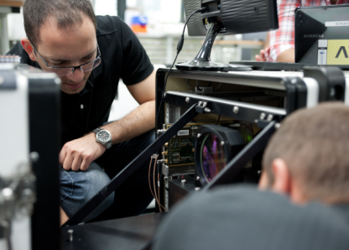
About Leosphere
Founded in 2004; independently owned
Designs, develops, manufactures, sells and services turnkey remote-sensing instruments for wind measurement and aerosol characterization
More than 750 Lidars sold in 50+ countries in several market: Wind power (70%), Meteorology, Aviation weather
Global headquarters: Orsay, France

Slide 3

About Renewable NRG Systems
Founded in 1982.
Manufactures and distributes decision support tools for the renewable energy and broader meteorology industries.
Sells, services and supports Leosphere Lidars in North America.
Global headquarters in Hinesburg, Vermont.

Slide 4
Agenda
4-beam Wind Iris description
Wind speed reconstruction algorithm description
Metrological validation of the 4-beam Wind Iris
Power performance testing from 4-beam Wind Iris

Slide 5
4-beam Wind Iris description

Slide 6
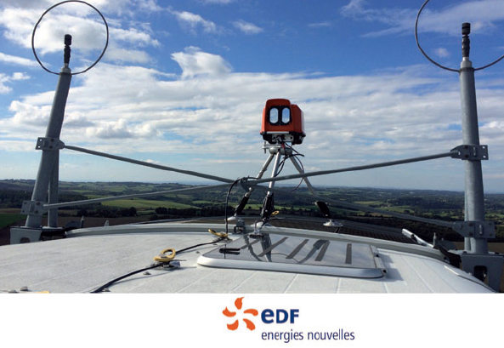
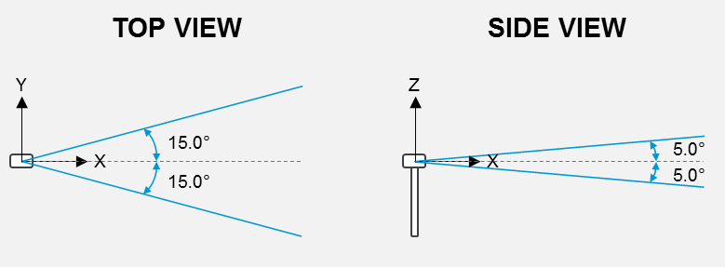
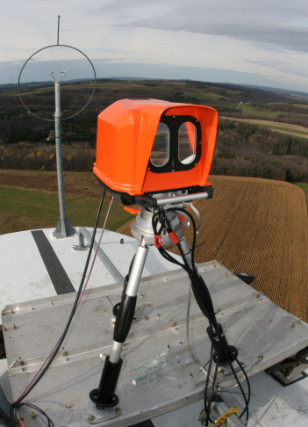
4-beam Wind Iris
The 4-beam Wind Iris (“Wind Iris 2”) is the new Leosphere Lidar dedicated to power curve measurement and performance optimization
2 beams measure upward and 2 beams measure downward.
The horizontal opening angle is 30°, similar to 2-beam Wind iris
The vertical opening angle is 10°, for shear measurements
New design optimized for operation, service and cost.
Two three month campaigns at operational wind farms :
USA : Sun Edison and DNV GL. Presented at PCWG 3/25/2015. Paul Lawson, “3D Nacelle Mounted Lidar in Complex Terrain”
Europe, France: EDF EN. Simple terrain. To be presented today!

Slide 7
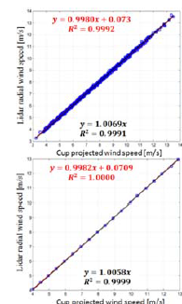
4-beam Wind Iris calibration
In the framework of UniTTe (Uniform Turbine Testing), a procedure for 4-beam Wind Iris calibration has been designed : “White box” type.
Comparison of radial wind speed measurement with cup anemometer undertaken at RISOE test site showed high agreement.
Leosphere has also designed along with DTU an in-house calibration based on reference Lidars which is available for Windcube and may be extended to Wind Iris (“Lidar to Lidar calibration”).
GENERIC CALIBRATION PROCEDURES FOR NACELLE-BASED PROFILING LIDARS; A. Borraccino, M. Courtney, R. Wagner; DEWEK 2015

Slide 8
Wind speed reconstruction algorithm description

Slide 9
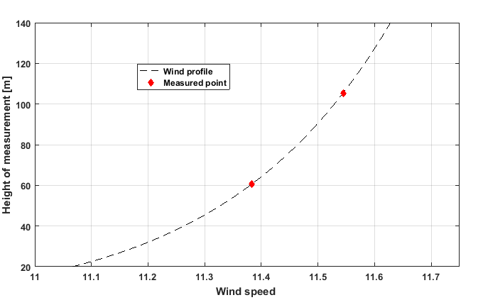
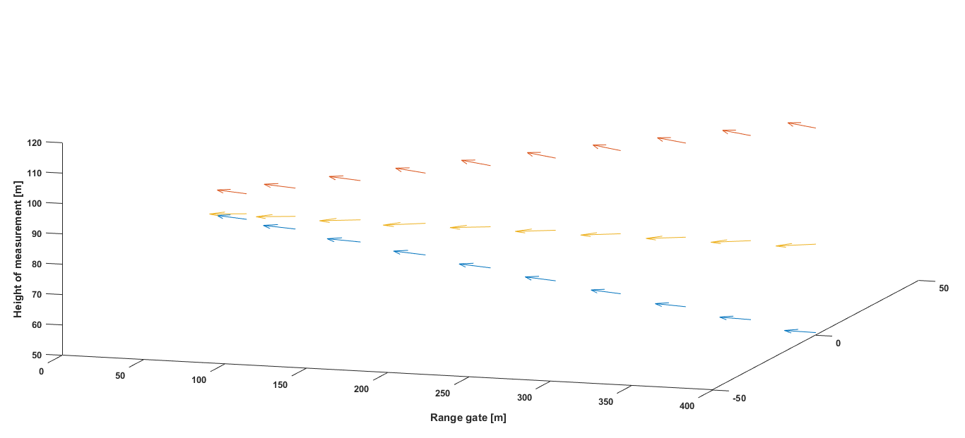
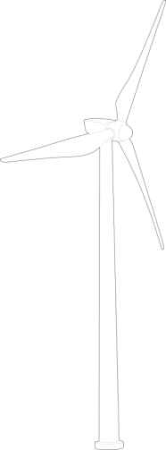
Wind profile is reconstructed
For each of 10 measurement distances :
Two wind speeds are measured at two different heights
The entire wind profile is then extrapolated

Slide 10
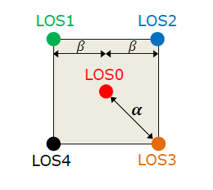
Wind characteristics are measured
Range gate | Range gate height difference [m]
#1 | 8
#2 | 13
#3 | 20
#4 | 27
#5 | 34
#6 | 40
#7 | 47
#8 | 54
#9 | 61
#10 | 67
From two heights of measurement, different wind characteristics are calculated:
Wind speed assuming log profile
Wind direction assuming linear profile
TI assuming log profile
β=5°

Slide 11
Metrological validation of the 4-beam Wind Iris

Slide 12
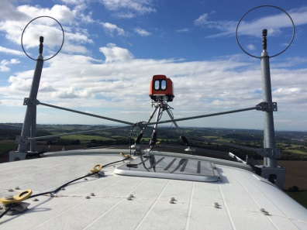
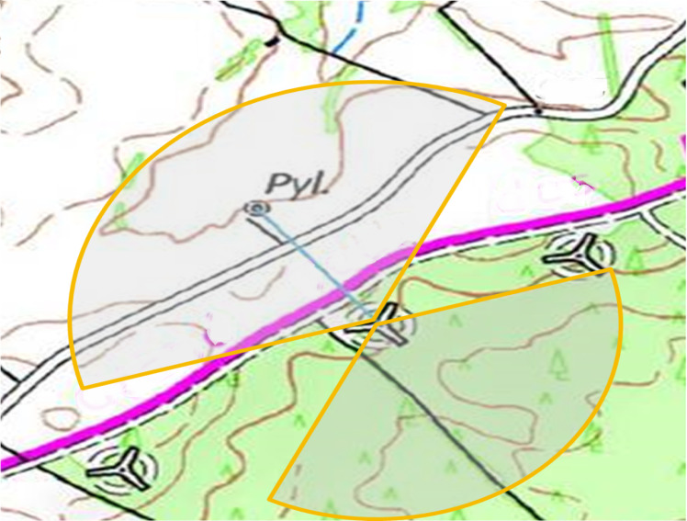
A simple terrain site in southern France
Turbine | Turbine 3MW, operated by EDF EN Services Hub-height: 80 meters Rotor size: 90 meters
IEC mast | Top cup at hub-height 240 meters (2.7D) from turbine Free wind sector: [315°;335°] Temperature above 0.1°

Slide 13
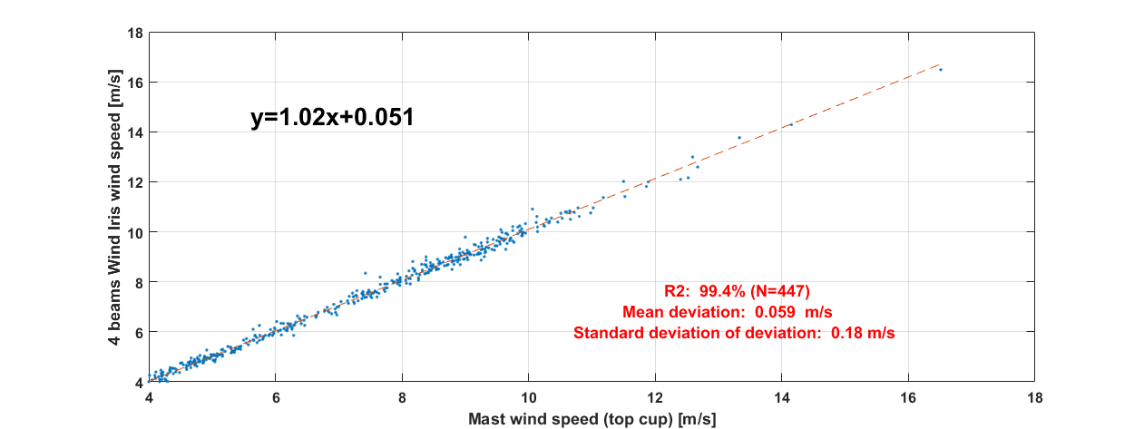
Wind speed : equivalent accuracy to 2-beam Wind Iris
Interpolated horizontal wind speed measurement is observed to achieve high accuracy and precision compared to IEC mast measurement.
No specific trend is observed (wind speed, wind direction,…)

Slide 14
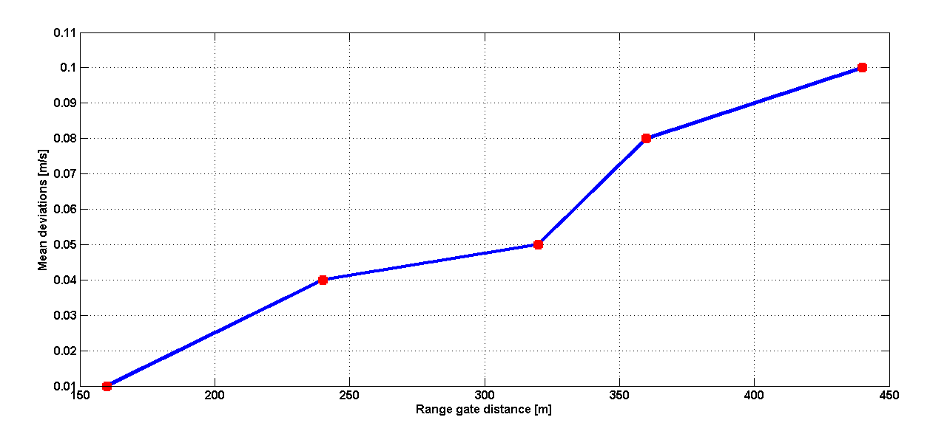
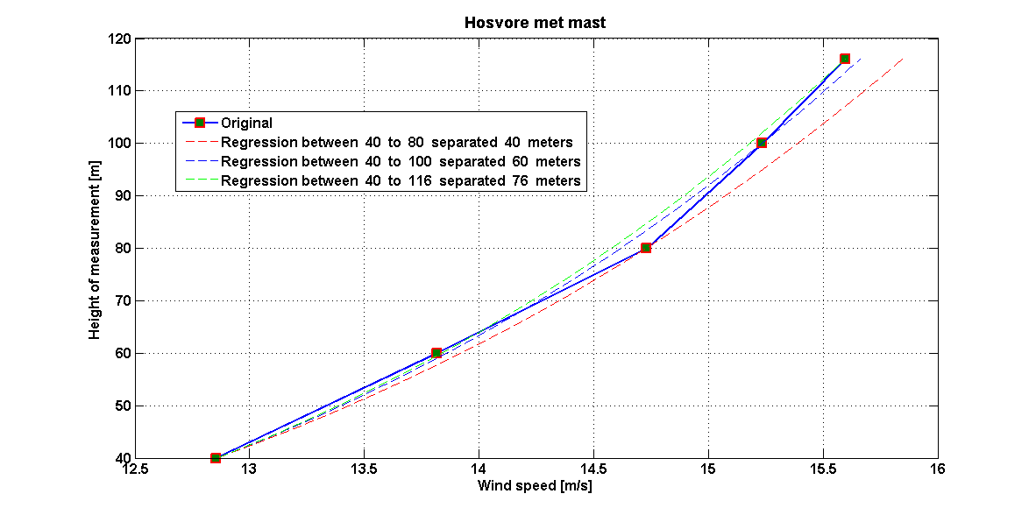

Uncertainty of power law interpolation
Hypothesis
$$\frac{V(Z)}{V(Z0)}={\left(\frac{Z}{Z0}\right)}^{α}$$
Reconstruction for a profile
Mean deviation between reconstructed profile
and measured wind speed
Mast measurements were used to compute uncertainties due to power law profile assumptions
The uncertainty due to interpolation lies between 0.01 m/s and 0.08m/s at this site.

Slide 15
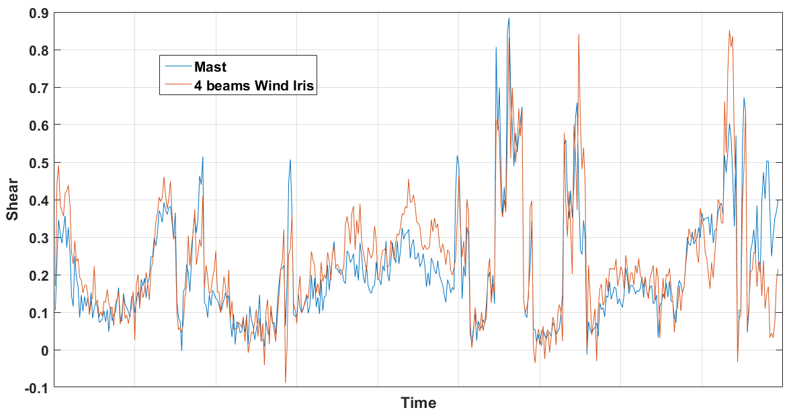
Shear measurement compared with mast
Shear measured by 4-beam Wind Iris is observed to match mast measurements most of the time.
Some difference appears: due to difference in measurement heights?

Slide 16
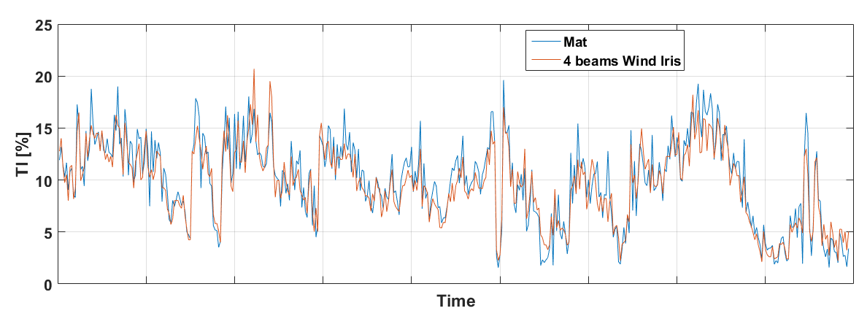
Turbulence intensity compared with mast
Turbulence intensity measured by 4-beam Wind Iris is observed to match the mast measurements most of the time.
Some difference appears: linked to atmosphere stability?

Slide 17
Metrology of 4-beam Wind Iris in simple terrain
 | Accuracy | Precision
Horizontal Wind speed | 0.06 m/s | 0.18 m/s
Vertical wind shear | 0.014 | 0.092
Turbulence Intensity | -0.4 % (absolute) | 1.5 % (absolute)

Slide 18
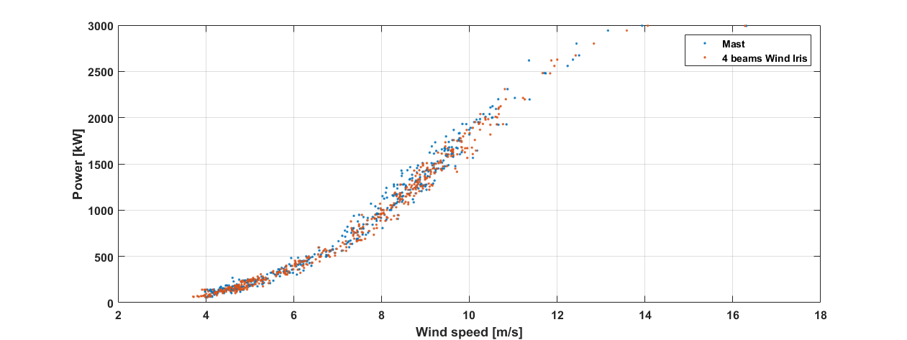
Validating 4-beam Wind Iris precision from power curve measurement
Power curve following the spirit of the IEC61400-12-1:2005 requirements (reduced wind sectors, temperature correction,…) is plotted with 4-beam Wind Iris measurements.
Mast based power curve is plotted over same time period so that devices are compared on same wind conditions.
Mean observed dispersion per bin is 81 kW for 4-beam Wind Iris and 111 kW for mast.
4-beam Wind Iris is observed to deliver a less scattered power curve than mast.
Notes:
Mast
Lidar
IEC PC
Not reached
33 days
Ope. PC
58 days
8 days

Slide 19
Power performance testing from 4-beam Wind Iris

Slide 20
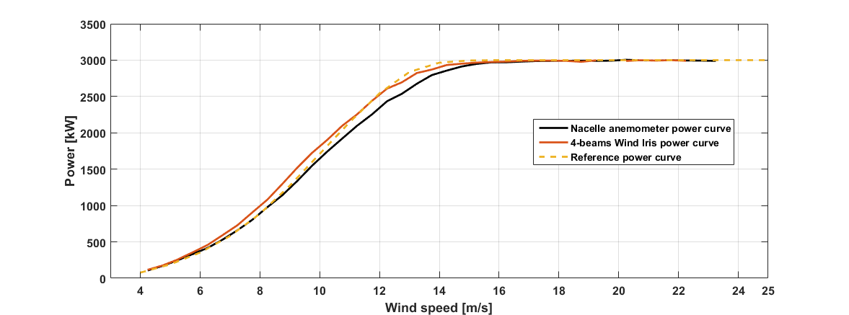
Power performance analysis
Power curves are plotted following adapted requirements established within the EUDP project (Procedure for wind turbine power performance measurement with a two-beam nacelle lidar, Rozenn Wagner, Rebeca L Rivera, Ioannis Antoniou, Samuel Davoust, Troels F Pedersen, Mike Courtney, Ba-bak Diznabi , 2013)
The 4-beam Wind Iris based power curve is in high agreement with the reference power curve -> no underperformance detected.
Nacelle anemometer wind measurement is biased (4% overestimation of the nacelle transfer function).
The nacelle anemometer based power curve is significantly under the reference power curve and erroneously shows underperformance.

Slide 21
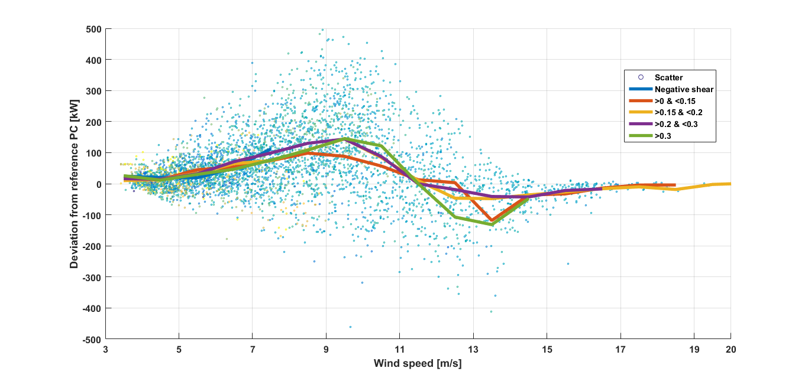
Shear effect on power performance
The higher the shear the more turbine performance deviates from reference (either underperforming or outperforming)

Slide 22
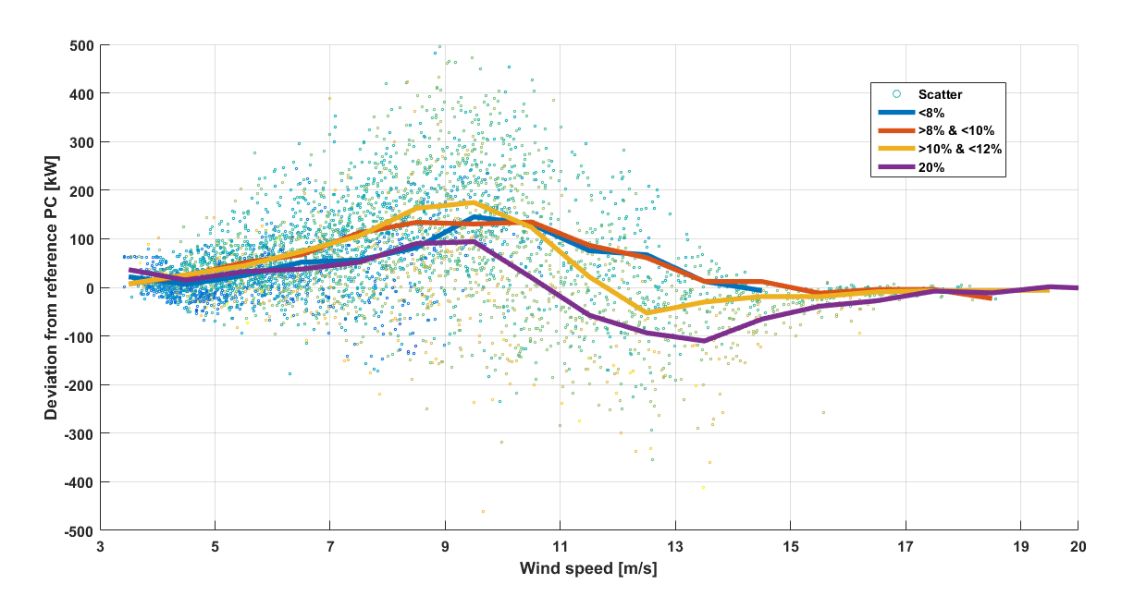
Turbulence intensity effect on PP
The higher the TI the lower the performance of the turbine is.

Slide 23
Conclusion

Slide 24
Conclusions
Metrological performances of the new system are observed to be in continuity of the well established 2-beam Wind Iris.
4-beam Wind Iris provides both shear and turbulence intensity measurements with good accuracy and precision, although there are deviations which may be explained by the difference in measurement heights.
4-beam Wind Iris will allow for improvement in understanding of wind turbine performance in outer range conditions.

